Slide 1
DX BALL RE-MASTERED

Slide 2
Project Type: Game Developing
Group Members : Lamia Nazrin
ID: 16-01-04-103
Mehedi Hasan
ID: 16-01-04-102
Somiya
ID: 16-01-04-088

Slide 3
CONTENT
DX BALL FEATURES
DEMO IMAGE
HOW TO PLAY
DIFFICULTIES
SCORING POINTS

Slide 4
DX Ball Re-Mastered Features :
Game Name : DX Ball Re-Mastered
Game Type : Puzzle Game
Player Mode : Single Player
Description : The main theme of the game is to break bricks by a bouncing ball from a paddle , that is at the bottom, hitting the bricks on the top of the screen without having the ball fallen down from the paddle . The ball can move in 6 ways. The paddle can move in 2 ways and everything will be handled by the mouse.

Slide 5
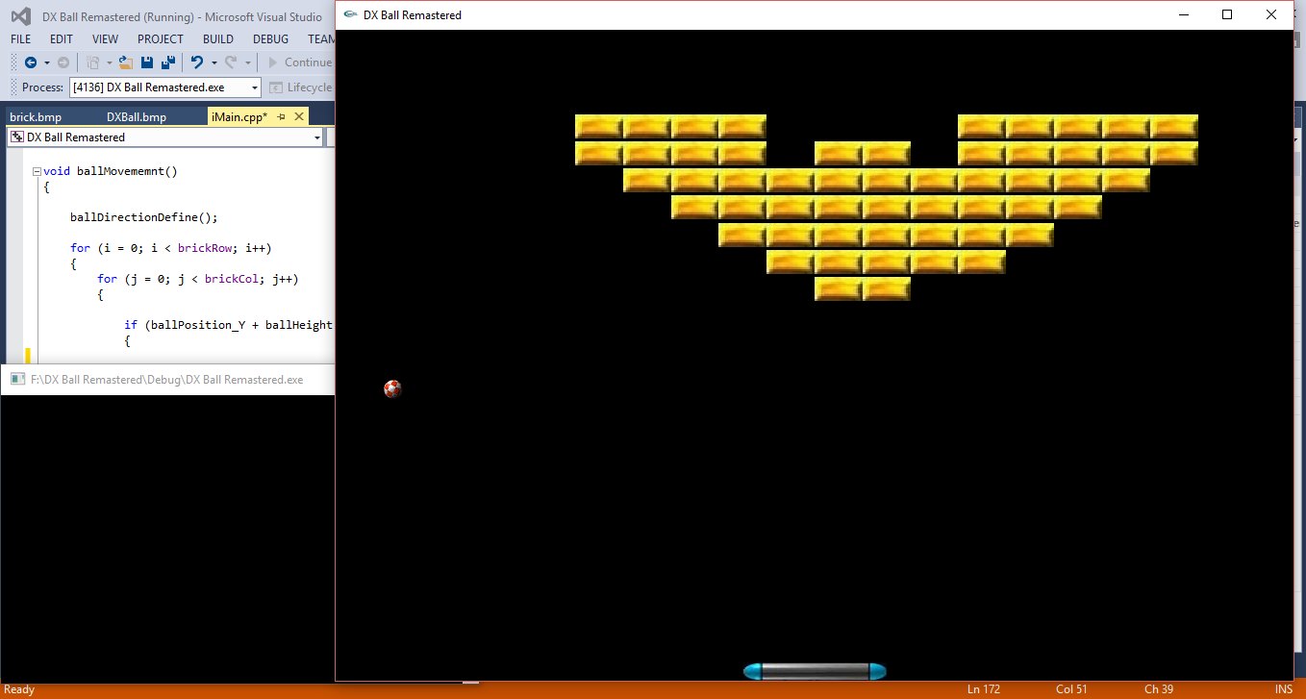
Demo image :

Slide 6
HOW TO PLAY :
To play this game , one will have to to break all the bricks with a ball . And when one will be able to break all the bricks , he/she can proceed to the next level.
The game will have three levels.
While playing , if the ball falls down from the paddle , the game will be over . And to continue the player will be given three chances.

Slide 7
difficulties :
There will 3 levels to end the game .
By the increasing of levels , the game will get harder.
First level will be a beginner level .
In second level we have to break more bricks.
And there will be time limitations in 3rd level.

Slide 8
Scoring points :
Player will get 5 points for breaking each brick.

Slide 9

GAME OVER

